Slide 1

START Hack 2024 | City of St. Gallen
Nicola Wullschleger, Public Service Design and Innovation Specialist
St. Gallen, March 20th 2024

Slide 2

ABOUT US

Slide 3


We are part of the Digital Transformation team of the city of St. Gallen
j
Nicola Wullschleger
Public Service Design and Innovation Specialist
j
Mariia Kolisnyk
Organizational Development and Digital Transformation Intern

Slide 4



Case content experts at the Rotmonten-Gerhalde Primary School (SUM)
j
Marco Käppeli
Principal of Rotmonten-Gerhalde Primary School
Responsible for the case content and its implementation
j
Claude Angehrn
School principal of Gerhalde Primary School
j
Michael Büche
Teacher at Rotmonten Primary School
START Hack 2024 | Deep Dive | 20.03.2024

Slide 5

Availability and contact information during START Hack 2024
Availability at the booth
Experts
Communication channels
There is a possibility to ask questions to a group of teachers from the Rotmonten-Gerhalde primary school.
Wednesday
8 pm – 10 pm
Thursday
10 am – 12 am
6 pm – 8 pm
Please come directly to the booth during the assigned time slots.
START Hack 2024 | Deep Dive | 20.03.2024

Slide 6

Your Mission
Proposing a digital tool to optimize the student assessment process for the educational staff
By addressing the following aspects
Supporting Teachers
Monitoring Children’s Development
Enhancing Transparency for Parents
and ultimately work towards a smarter educational system!
START Hack 2024 | Deep Dive | 20.03.2024

Slide 7
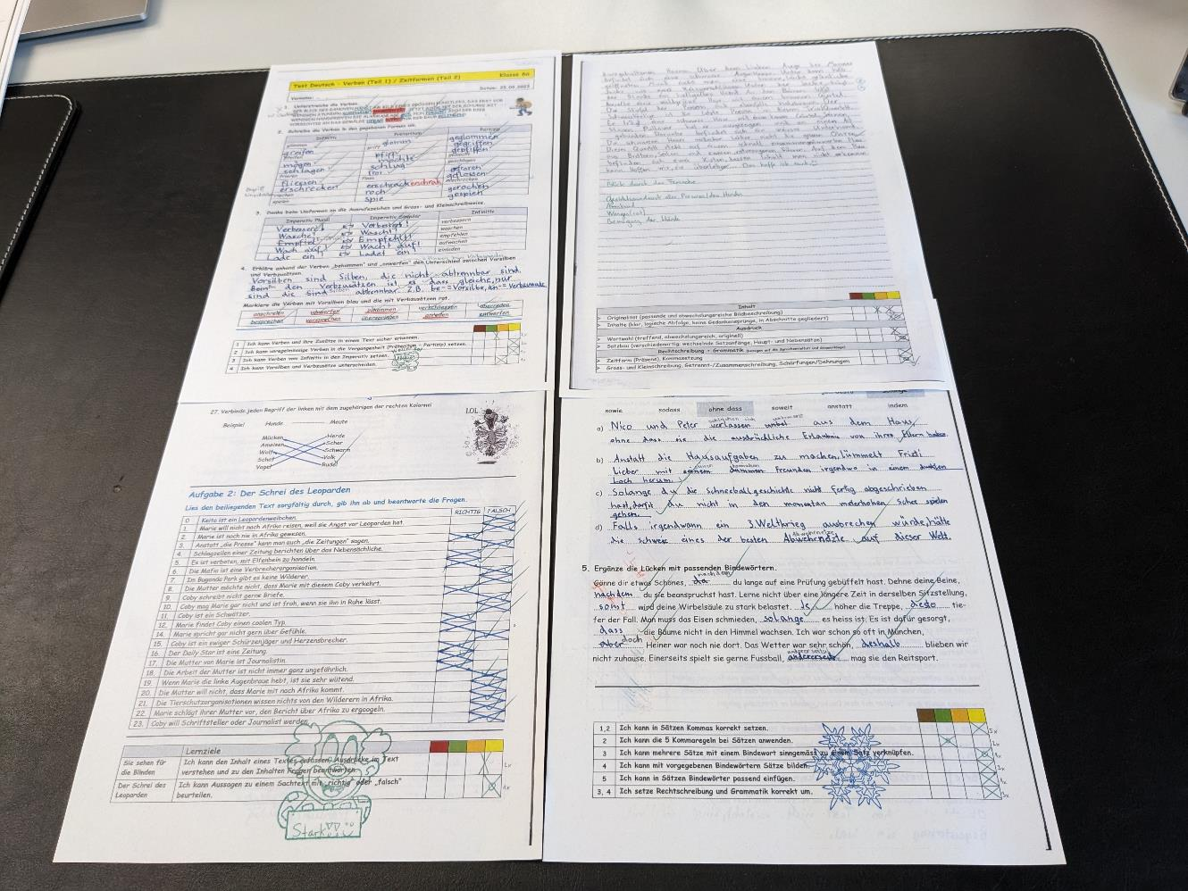
What a pain?
START Hack 2024 | Deep Dive | 20.03.2024
Notes:
The school utilizes assessment grids for student evaluation, marking a shift from traditional grading methods.

Slide 8
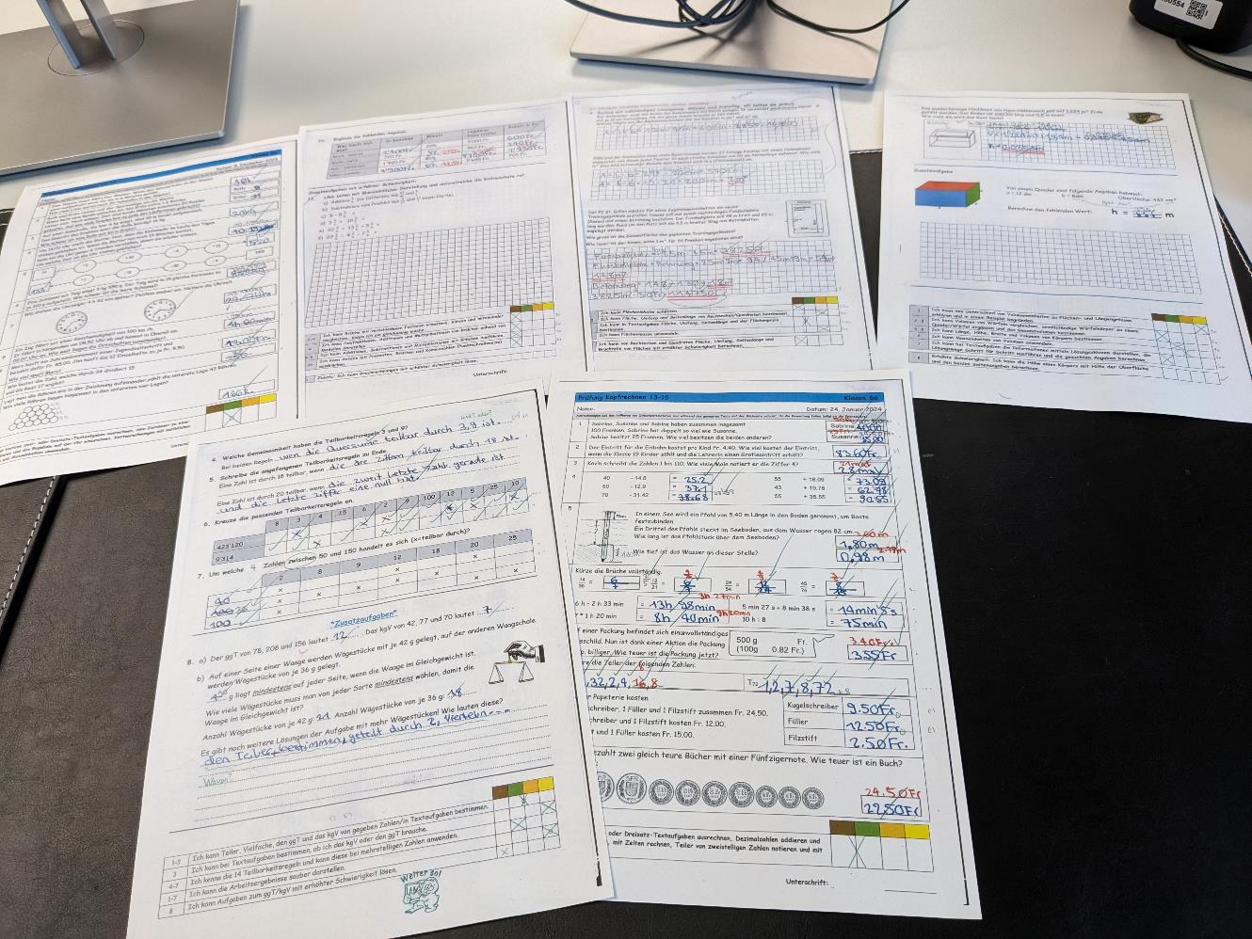
What a pain?
START Hack 2024 | Deep Dive | 20.03.2024
Notes:
The school utilizes assessment grids for student evaluation, marking a shift from traditional grading methods.

Slide 9
YOUR CHALLENGE
Notes:
Let’s dive deeper now into your challenge.

Slide 10

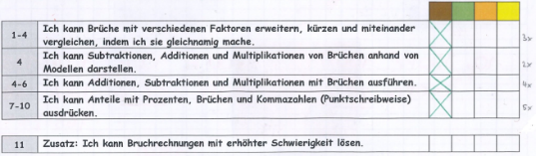
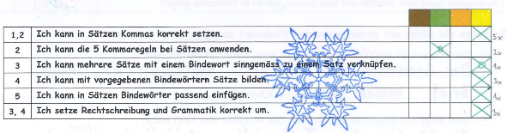
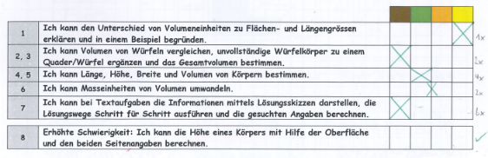
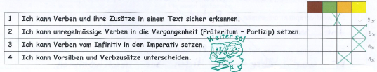
This process can be customized and executed more efficiently…
START Hack 2024 | Deep Dive | 20.03.2024
Notes:
As we’ve seen, teachers are often overwhelmed by the sheer volume of paperwork they must manage. That’s why the evaluation process should be redesigned to prioritize efficiency, ensuring that it not only becomes more manageable but also more effective.

Slide 11
What are the current problems?
Difficult overview on paper
Lack of structure and support in grading
Inconsistency and incomparability across classes
Transparency and traceability issues
Challenging curriculum alignment
Insufficient focus on interdisciplinary learning objectives
START Hack 2024 | Deep Dive | 20.03.2024
Notes:
What are the problems with the current student evaluation process? Several key issues stand out. Firstly, managing paper-based evaluations makes it difficult to get an overview of student’s progress. The lack of a uniform structure leads to inconsistency and makes comparisons across different classes challenging. Furthermore, monitoring each student’s progress over time is burdensome. It’s rather complicated to align the learning objectives with the curriculum. Moreover, the paper-based process often overlooks interdisciplinary learning objectives, which are crucial for comprehensive education.

Slide 12
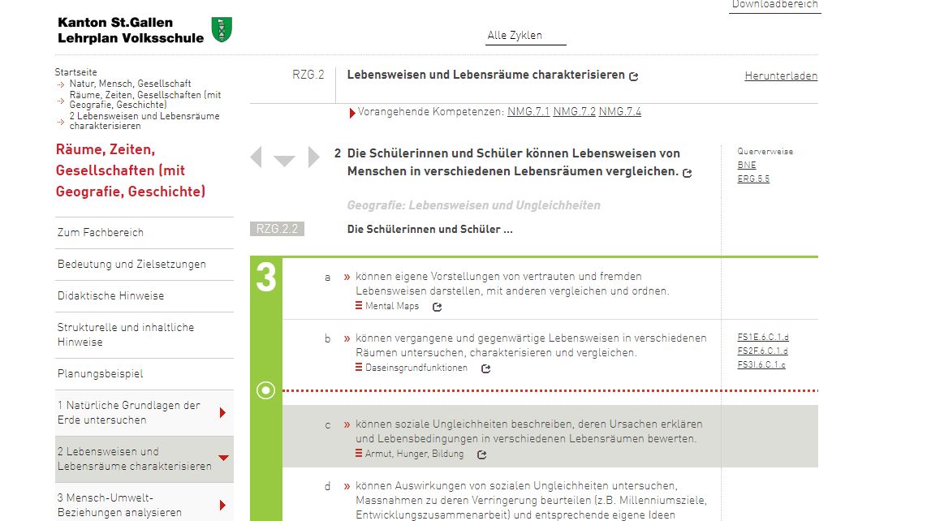
Curriculum 21
Notes:
Here you can see an excerpt from the curriculum on the website that teachers use to derive learning objectives from, which in turn are used for the assessment of the students.

Slide 13

The process of creating, evaluating, and tracking learning objectives lacks digital support…
… with help of which a teacher should be able to…
Derive learning objectives
Capture Evaluations
Obtain Comprehensive Overview
Receive Support for Final Assessment
Demonstrate Learning Progress
Derive learning objectives from the curriculum, covering both subject-specific and interdisciplinary competences
Record evaluations from test results and personal observations of each student’s performance
Gain a comprehensive evaluation overview of all exams and observations
Receive support for the final assessment and grading process
Showcase student’s learning status and areas needing improvement during parent-teacher meetings or to the students themselves
START Hack 2024 | Deep Dive | 20.03.2024

Slide 14



Enhancing your solution’s value with capabilities
Provides a clear overview of various evaluations, including observations and test results
Visually aggregates information to aid teachers in the grading process
Makes evaluations understandable to parents and students
Enables creation of specific learning objectives aligned with competencies when needed
Facilitates finding and leveraging overlaps in competencies to build comprehensive learning objectives, while also identifying gaps in the assessment of Curriculum 21
Tracks and displays student’s progress in alignment with Curriculum 21
Digitally supported teaching
START Hack 2024 | Deep Dive | 20.03.2024
Notes:
The value of the digital tool you are creating is derived from two aspects, which intersect and complement each other. On one hand, the tool should enable the creation of specific learning objectives, facilitate building comprehensive learning objectives as well as track and display student’s progress in alignment with Curriculum 21.

Slide 15




Who are the potential users of this solution?
Teachers & Administrative Staff
Use the tool for objective setting, performance evaluation, and progress tracking
Share student results in discussions and strategy planning
Students
Receive personalized feedback and progress insights indirectly through teachers
Parents
Gain insights into their child’s progress during discussions with teachers
START Hack 2024 | Deep Dive | 20.03.2024

Slide 16

Which resources are at your disposal?
Unstructured Data
Structured Data
Personal “Data”
Analog evaluations from two subjects
Lehrplan 21 (Website content)
API Access to Lehrplan 21
Lehrplan 21 Additional Files (CVS format)
Structured Evaluations (CSV format)
Access to up to 4 teachers for additional information
START Hack 2024 | Deep Dive | 20.03.2024

Slide 17
Curriculum 21

Slide 18
What should you focus on?
Creativity & Innovation
Novelty and differentiation of the solution
Usefulness
Relevance and practicality for diverse users
Technical complexity
Technical sophistication and appropriate methodology
Execution & Design
Usability, functionality, and design quality
Presentation
Clarity and significance of project presentation
This case tackles a real-world challenge. Solutions that offer the most utility to us are highly valued!
START Hack 2024 | Deep Dive | 20.03.2024

Slide 19



START Hack 2024 | Deep Dive | 20.03.2024

Slide 20

THANK YOU FOR YOUR ATTENTION! ARE THERE ANY QUESTIONS?
START Hack 2024 | Deep Dive | 20.03.2024

